Slide 1
Economic outlook: Uzbekistan
Eric Livny, Lead Regional Economist, Central Asia
February 2022
PUBLIC

Slide 2
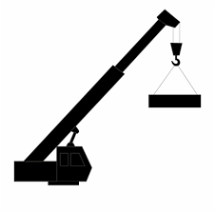
In 2022, Central Asian economies have proven resilient to Russia’s war on Ukraine
Uzbekistan’s growth was broad-based…
+5.5% y/y Industry
+6.6% y/y Construction
+3.6% y/y Agriculture
+8.5% y/y Services
+15.9% y/y Exports

Slide 3
Unlike some of its neighbours, Uzbekistan did not significantly benefit from elevated commodity prices
Product | Brent oil | Copper | Wheat | Gold | Coal | Aluminium | Natural gas
Average price in 2022 compared to 2021 average | +41.7% | -5.8% | +36.4% | = | +149.7% | +9.3% | +150%
Notes:
Yet, the mining industry’s output dropped by 1% in Kazakhstan, driving by a 21% drop in iron ore mining. Oil extraction dropped 2%, metal ore and natural gas by 1%.
Oil and gas industry in Turkmenistan was the big winner: in January-November 2022, production plans have been over fulfilled for gasoline (by 14,9%), diesel fuel (by 10.4%), polypropylene (by 19.6%), lubricating oils (by 4.7%), liquefied gas (by 7%) and natural and associated gas (by 13.6%).

Slide 4
Contrary to the earlier expectations, all CA countries have increased exports (Kyrgyzstan is a special case)…
Chemicals
Non-ferrous metals
Other goods
Energy
Food
Cars and equipment
Gold
 | Growth rate, y/y
Cotton | -97.4%
Chemical products and articles thereof | 17.0%
Black metals | 37.1%
Non-ferrous metals | -1.6%
Energy and oil products | 33.8%
Cars and equipment | 41.0%
Gold | 0.0%
Food | 23.9%

Slide 5
… having assumed a large role in Russia’s “intermediated trade” with Türkiye and China…
Chinese exports to or through Kyrgyzstan increased +119% in the first 11 months of 2022, reflecting its role as a gateway for Chinese products into the EEU. Kyrgyzstan’s exports were driven by very large y/y increases in clothing (x3.3), cotton fibre, yarn and fabrics (x7), and footwear (x13).
Uzbekistan’s exports to Russia include more than US$100 million in consumer electronics.

Slide 6
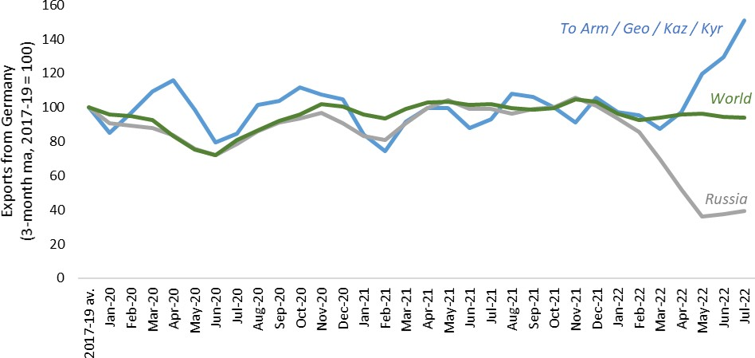
… as well as Russia’s “intermediated trade” with EU/UK
Germany’s exports to Russia, world and CCA4
24 January, 2023
6

Slide 7
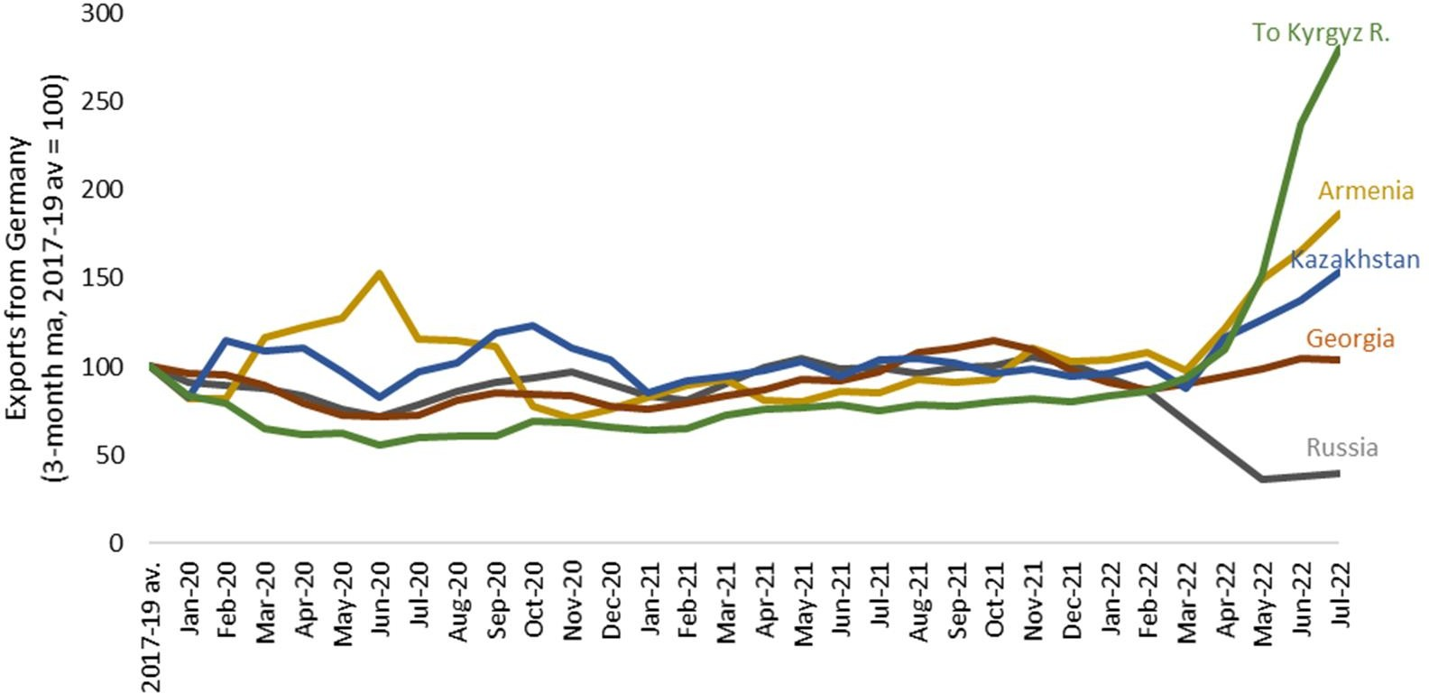
Kyrgyz Republic and Armenia are champions of intermediated trade among CCA4
Germany’s exports to Russia, Georgia, Kazakhstan, Armenia and Kyrgyz Republic
TRANSITION REPORT 2022-23 Source: Comtrade and authors' calculations. As reported by exporters (eg Germany). Trade in nominal US dollars is adjusted for US inflation. Monthly average taken across all
BUSINESS UNUSUAL
months in 2017-19.

Slide 8
Early turbulence in foreign exchange markets ended by April 2022
Nominal change in Central Asian currencies vs. USD compared to December 31, 2021
RUB
TJS
KGS
UZS
KZT
MNT

Slide 9
Remittances have grown contrary to earlier estimates (and are likely to further increase)
In KYR, remittances increased by 9% in Jan-Nov 2022. However, the net balance of remittances worsened (-17.9%), potentially reflecting the re-routing of Russian capital via Kyrgyzstan to other countries
The Russian economy is likely to remain hungry for Central Asian workers:
According to the IMF, the Russian economy contracted by only 2.2% in 2022. Growth is expected to pick up in 2023 and 2024 (0.3% and 2.1%, respectively)
Russia’s unemployment reached an all time minimum of 3.7% in Nov 2022.
In TAJ, according to the IMF, remittances rebounded sharply in Q2 after a short-lived dip immediately after Russia’s invasion, driving the current account surplus and boosting FX reserves in Tajikistan
In UZB, remittances reached US$16.9 billion (up +110% year-on- year, 23% of GDP)
Central Asian currencies have been appreciating vs. the Russian rouble in recent months, adding to the LCY value of remittances

Slide 10
The main challenge facing all Central Asian economies nowadays are inflation and the cost of borrowing
In H2 2022, Kazakhstan has emerged as the regional leader in inflation!
Strong growth of nominal wages coupled with a surge in transport, food and commodity prices added to inflationary pressures
Country | Inflation |  | Policy rate
 | December | January | Previous rate | Current rate
Kazakhstan | 20.3 | 20.7 | 16.0 (25.10.2022) | 16.75 (06.12.2022)
Kyrgyz Republic | 14.7 | 15.3 | 14 | 13
 |  |  | (10.03.2022) | (29.11.2022)
Mongolia | 13.2 | 12.3 | 12 (20.09.2022) | 13 (16.12.2022)
Tajikistan | 4.5 (November) | 4.3 | 13 (01.11.2022) | 11 (06.02.2023)
Uzbekistan | 12.3 (November) | 12.3 (December) | 16 (10.06.2022) | 15 (22.07.2022)
Despite monetary tightening inflation persists, reflecting a continuation of generous fiscal policies

Slide 11
Most countries in Central Asia managed to increase external reserves…
In 2023, public debt is expected to decline as a share of GDP on strong growth in all CA countries except Mongolia

Slide 12
Challenges and opportunities to the regional outlook
Upside
- The relocation of foreign firms and investment in new activities related to voluntary exit of major global players from Russia
- Political fragility feeding into inflationary pressures (and vice versa)
- China’s reopening providing support to commodity prices
- International interest in Central Asian transit, natural resources and green energy potential, including hydrogen
Downside
- Potential interruptions to oil transit through Novorossiysk, closing of Chinese borders crippling export revenues
- Political economy constraints (PEP presence in key sectors of the economy) standing in the way of reforms, privatization and investment

Slide 13
And more good news…
Uzbekistan has recently completed two major privatizations: Ipoteka-Bank (the 5th largest Uzbek bank) was acquired by Hungary’s OTP Bank; Ferganaazot (a major fertilizer producer) was acquired by the Singapore-based Indorama. Conducted in a transparent and competitive manner, these privatizations bode well for the future of the country’s privatization efforts. On the other hand, privatizations of Kyzylkumcement and Quartz (Uzbekistan’s largest producer of glass) to United Cement Group have been met with criticism.
A trilateral agreement signed at the SCO meeting in Samarkand in September 2022 to build the US$ 4-5 billion China-Kyrgyz Republic-Uzbekistan railway project. Frozen for more than 20 years, this project will enhance regional connectivity by creating strong competition on the east-west railway routes across Eurasia.
The process of border delimitation with the Kyrgyz Republic has been completed, likely to enhance bilateral trade. Agreements signed during President Mirziyoyev’s visit to Bishkek in January 2023, include the construction of Kambarata-I 2GW HPP project.
Addressing growing demand for energy, over the past 4 years, contracts have been concluded with international consortia for 9 TPPs with total capacity of 6 GW. Three facilities (4,6 GW) are under construction.
Uzbekistan introduced tax relief for households and enterprises installing small RE generators of up to 100 kW, adding 1,2 GW to RE capacity. Another 2,1 GW will come from large solar plants and wind farms.
Uzbekistan’s agricultural sector continues to attract very significant FDI, with top 10 countries investing close to $400mln in 2022. Turkiye, UAE, China and Russia are top investors, with greenfield projects ranging from cannabis to livestock & meat processing to greenhouses to packaging & logistics.

Slide 14
Contacts
Eric Livny Lead Regional Economist, Central Asia CESP, PSD Email: LivnyE@ebrd.com
Find us on social media

